Slide 1


Computational Intelligence (TC2023)

Slide 2
Unit 3 – Anomaly Detection (3)
Outline
A Neural Network Example

Slide 3

A Practical Example

Slide 4
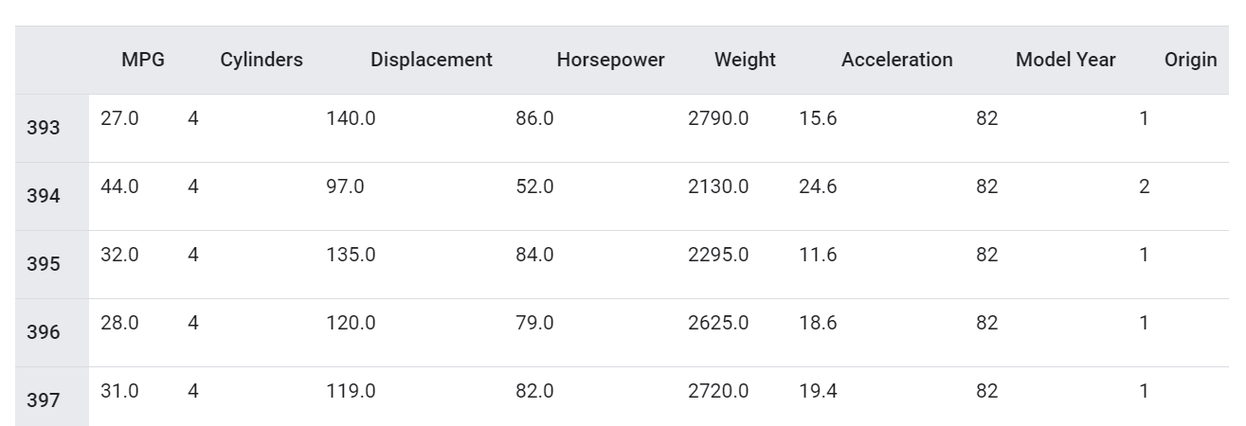
Dataset -> auto-mpg.data
The data concerns city-cycle fuel consumption in miles per gallon (MPG), to be predicted in terms of 3 multivalued discrete and 5 continuous attributes.

Slide 5
AAN Steps
Process the data and split into a training and test set
Build the Artificial Neural Network Structure
Train the Artificial Neural Network
Use the model to predict!
Tune the model for better accuracy

Slide 6

Process the data and split into a training and test set

Slide 7
Import dataset
column_names = ['MPG','Cylinders','Displacement','Horsepower','Weight', 'Acceleration', 'Model Year', 'Origin'] dataset = pd.read_csv("../resources/auto-mpg.data", names=column_names, na_values = "?", comment='\t', sep=" ", skipinitialspace=True)

Slide 8
Clean the dataset
print(dataset.isna().sum()) dataset = dataset.dropna()
Check the existence of Null values into dataset

Slide 9
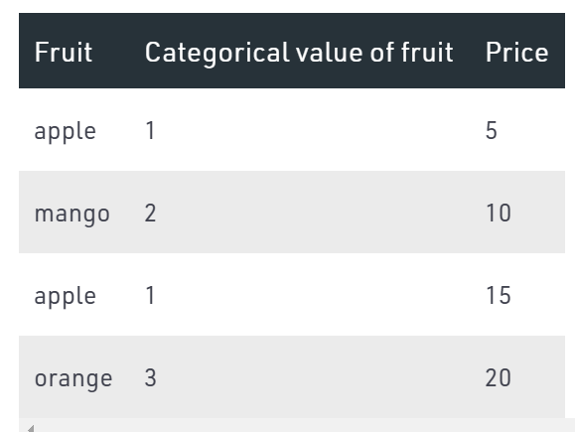
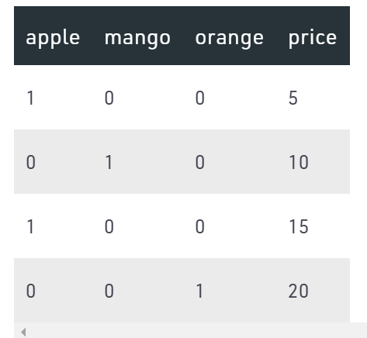
One Hot Enconding
The data may be quantitative (numerical) or qualitative (categorical). The numerical data can be easily handled in regression models, but we can’t use categorical data directly, it needs to be transformed in some way.
For transforming categorical attribute to numerical attribute, we can use label encoding procedure (label encoding assigns a unique integer to each category of data) -> One hot encoding.

Slide 10
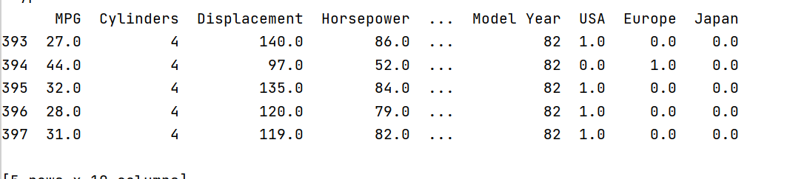
origin = dataset.pop('Origin') dataset['USA'] = (origin == 1)*1.0 dataset['Europe'] = (origin == 2)*1.0 dataset['Japan'] = (origin == 3)*1.0 print(dataset.tail())
The column origin can be understood as a categorical
Drop method, save the value into a new dataset and drop the column into the original dataset

Slide 11
Dummy Variable
The Dummy variable trap is a scenario where there are attributes which are highly correlated (Multicollinear) and one variable predicts the value of others.
Name | Gender
Pedro | Man
Lucia | Woman
Claudio | Man
Name | Man | Woman
Pedro | 1 | 0
Lucia | 0 | 1
Claudio | 1 | 0
However, if the person is a man, he cannot be a woman.
In this case, we can delete one column.
X = X[:, 1:]

Slide 12
Split the data into training and test
train_dataset = dataset.sample(frac=0.8,random_state=0) test_dataset = dataset.drop(train_dataset.index) train_labels = train_dataset.pop('MPG') test_labels = test_dataset.pop('MPG')

Slide 13
Normalize the dataset
train_stats = train_dataset.describe() train_stats = train_stats.transpose() def norm(x): return (x - train_stats['mean']) / train_stats['std'] normed_train_data = norm(train_dataset) normed_test_data = norm(test_dataset)
Transpose: Permute the dimensions of a given array.

Slide 14

Build the Artificial Neural Network Structure

Slide 15

Keras is an API designed for human beings, not machines.
Keras follows best practices for reducing cognitive load: it offers consistent & simple APIs, it minimizes the number of user actions required for common use cases, and it provides clear & actionable error messages.
It also has extensive documentation and developer guides.

Slide 16

TensorFlow is an end-to-end open-source platform for machine learning.
It has a comprehensive, flexible ecosystem of tools, libraries and community resources that lets researchers push the state-of-the-art in ML and developers easily build and deploy ML powered applications.

Slide 17
Required Packages
# Installing Tensorflow pip install tensorflow # Installing Keras pip install --upgrade keras

Slide 18
import tensorflow as tf from tensorflow import keras from tensorflow.keras import layers def build_model(): model = keras.Sequential([ layers.Dense(64, activation='relu', input_shape=[len(train_dataset.keys())]), layers.Dense(64, activation='relu'), layers.Dense(1) ]) optimizer = tf.keras.optimizers.RMSprop(0.001) model.compile(loss='mse', optimizer=optimizer, metrics=['mae', 'mse']) return model
A Sequential model is appropriate for a plain stack of layers where each layer has exactly one input tensor and one output tensor.
Notes:
In statistics, overfitting is "the production of an analysis that corresponds too closely or exactly to a particular set of data,and may therefore fail to fit additional data or predict future observations reliably".

Slide 19
import tensorflow as tf from tensorflow import keras from tensorflow.keras import layers def build_model(): model = keras.Sequential([ layers.Dense(64, activation='relu', input_shape=[len(train_dataset.keys())]), layers.Dense(64, activation='relu'), layers.Dense(1) ]) optimizer = tf.keras.optimizers.RMSprop(0.001) model.compile(loss='mse', optimizer=optimizer, metrics=['mae', 'mse']) return model
model = build_model()
Dense is an entry level layer which accepts the number of neurons or units (32) as its required parameter.
Notes:
In statistics, overfitting is "the production of an analysis that corresponds too closely or exactly to a particular set of data,and may therefore fail to fit additional data or predict future observations reliably".

Slide 20
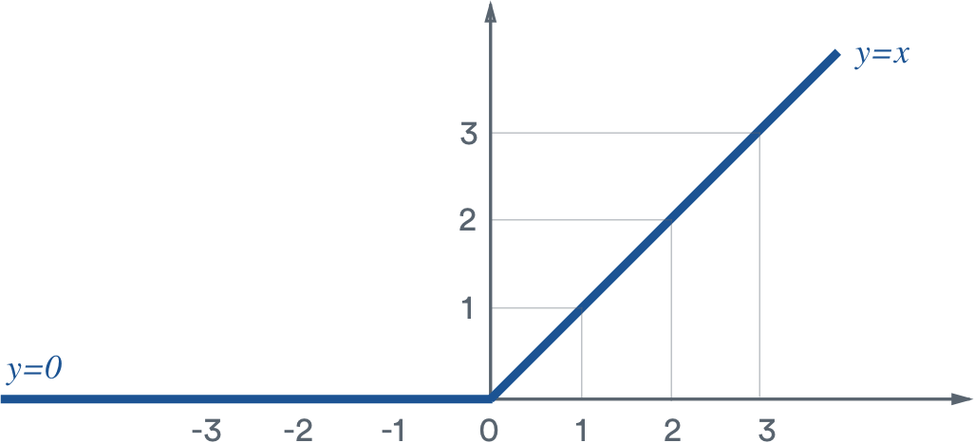
ReLU Activation Function
ReLU stands for rectified linear unit and is a type of activation function.
Mathematically, it is defined as y = max(0, x).
The slope doesn’t plateau, or “saturate,” when x gets large. It doesn’t have the vanishing gradient problem suffered by other activation functions like sigmoid or tanh.
It’s sparsely activated. Since ReLU is zero for all negative inputs, it’s likely for any given unit to not activate at all. This is often desirable (see below).

Slide 21
import tensorflow as tf from tensorflow import keras from tensorflow.keras import layers def build_model(): model = keras.Sequential([ layers.Dense(64, activation='relu', input_shape=[len(train_dataset.keys())]), layers.Dense(64, activation='relu'), layers.Dense(1) ]) optimizer = tf.keras.optimizers.RMSprop(0.001) model.compile(loss='mse', optimizer=optimizer, metrics=['mae', 'mse']) return model
model = build_model()
Optimizer that implements the Square of Gradients.
The parameter is the learning rate of optimizer.
Notes:
In statistics, overfitting is "the production of an analysis that corresponds too closely or exactly to a particular set of data,and may therefore fail to fit additional data or predict future observations reliably".

Slide 22
import tensorflow as tf from tensorflow import keras from tensorflow.keras import layers def build_model(): model = keras.Sequential([ layers.Dense(64, activation='relu', input_shape=[len(train_dataset.keys())]), layers.Dense(64, activation='relu'), layers.Dense(1) ]) optimizer = tf.keras.optimizers.RMSprop(0.001) model.compile(loss='mse', optimizer=optimizer, metrics=['mae', 'mse']) return model
model = build_model()
Notes:
In statistics, overfitting is "the production of an analysis that corresponds too closely or exactly to a particular set of data,and may therefore fail to fit additional data or predict future observations reliably".

Slide 23

Train the Artificial Neural Network

Slide 24
# Mostra o progresso do treinamento imprimindo um único ponto para cada epoch completada class PrintDot(keras.callbacks.Callback): def on_epoch_end(self, epoch, logs): if epoch % 100 == 0: print('') print('.', end='') EPOCHS = 1000 history = model.fit( normed_train_data, train_labels, epochs=EPOCHS, validation_split = 0.2, verbose=0, callbacks=[PrintDot()]) print('\n')

Slide 25
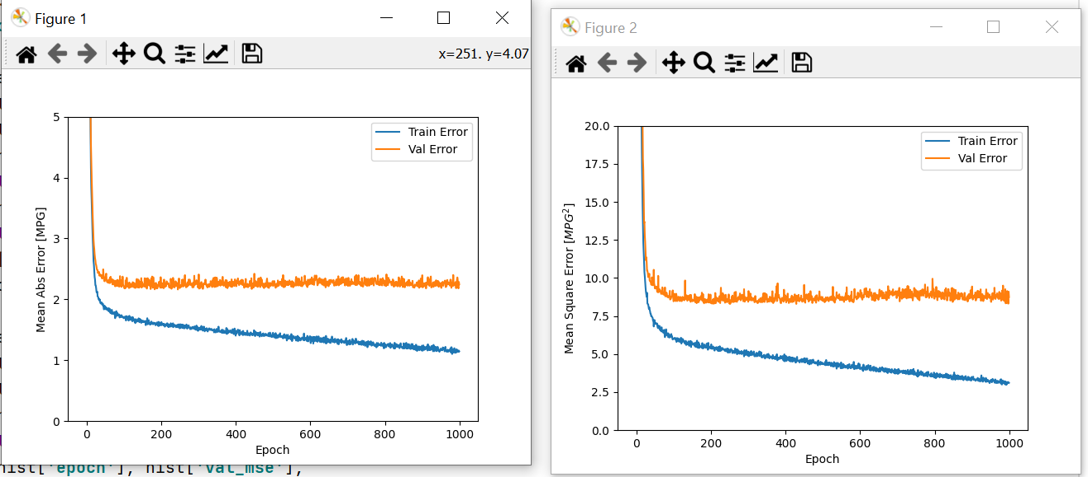

Slide 26

Use the model to predict!

Slide 27
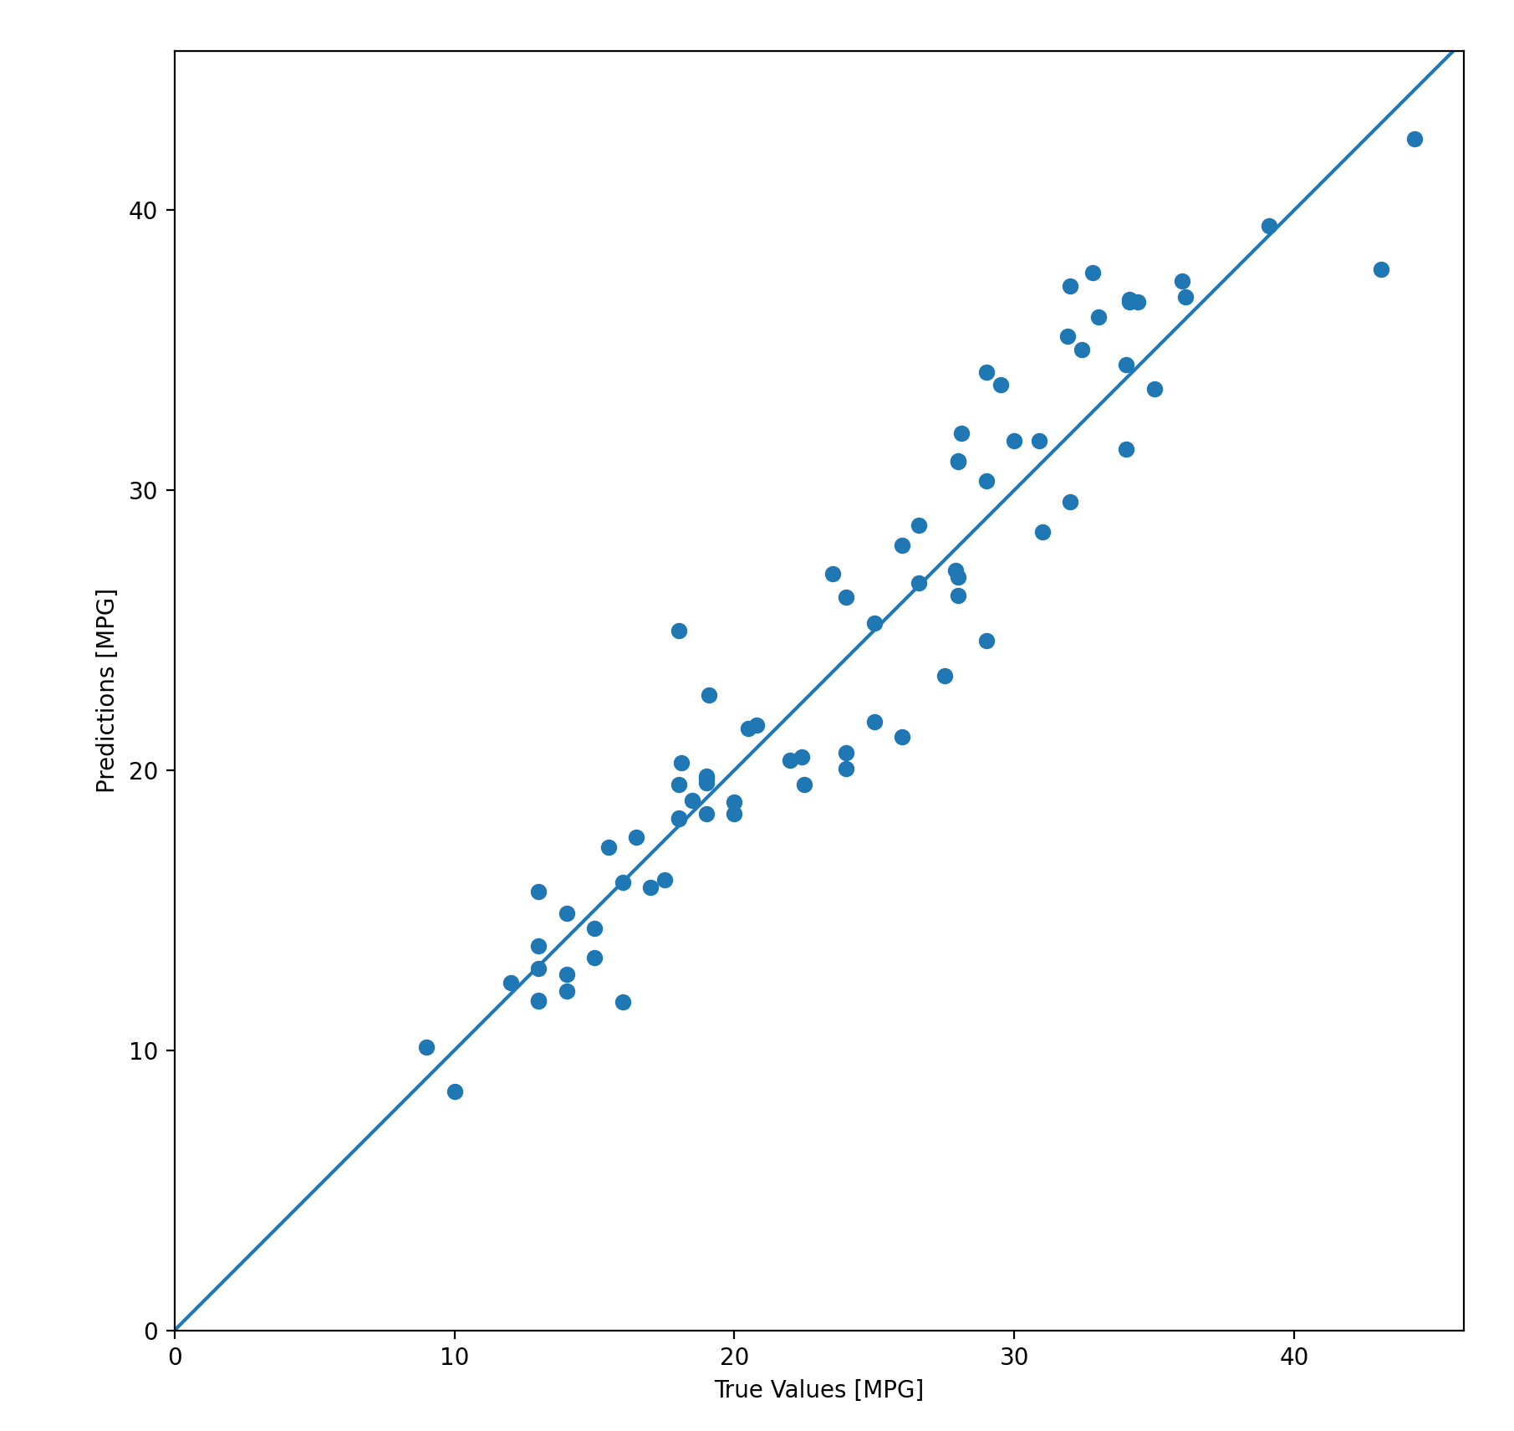
test_predictions = model.predict(normed_test_data).flatten() plt.scatter(test_labels, test_predictions) plt.xlabel('True Values [MPG]') plt.ylabel('Predictions [MPG]') plt.axis('equal') plt.axis('square') plt.xlim([0,plt.xlim()[1]]) plt.ylim([0,plt.ylim()[1]]) _ = plt.plot([-100, 100], [-100, 100]) plt.show() error = test_predictions - test_labels plt.hist(error, bins = 25) plt.xlabel("Prediction Error [MPG]") _ = plt.ylabel("Count") plt.show()

Slide 28
Computational Intelligence (TC2023)

